Slide 1
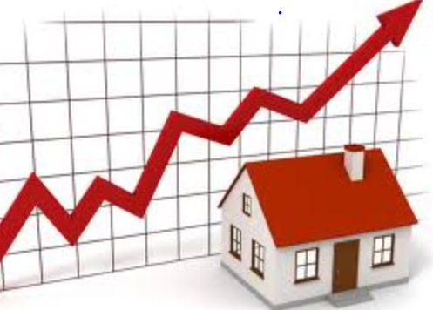

Springboard Data Analytics Program Capstone 1 Project King County, WA Housing Price Analysis and Prediction Using Multiple Linear Regression
Presenter: Adam Muffitt

Slide 2
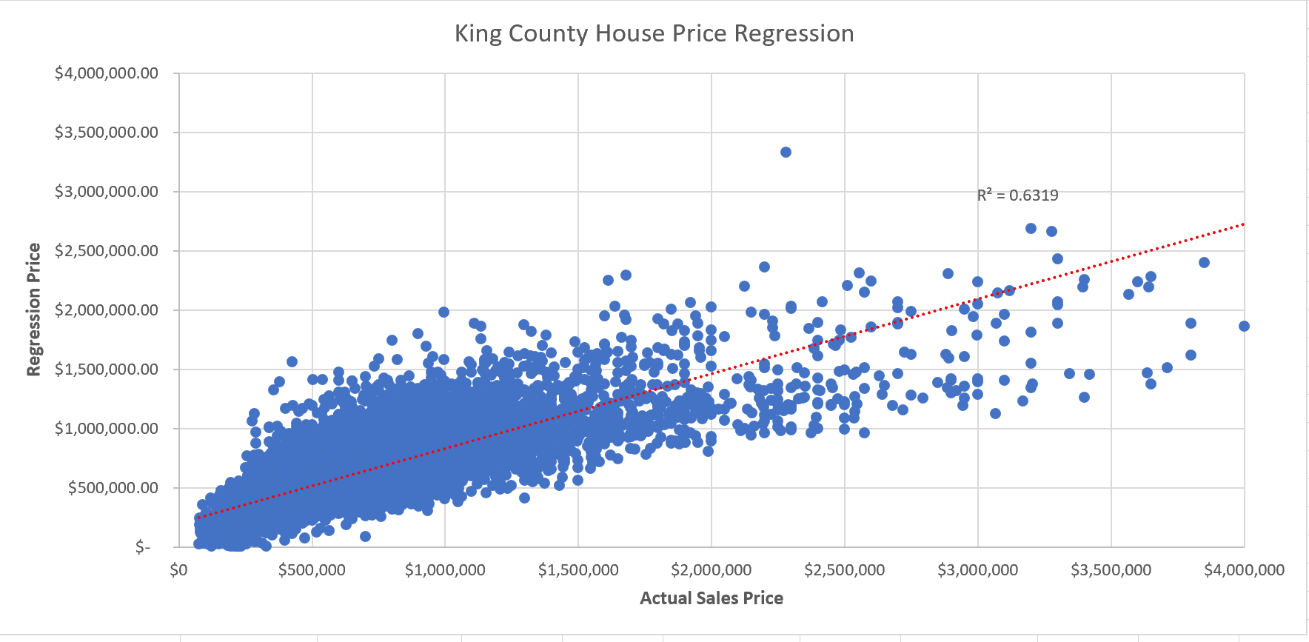
For King County, WA, a predictive pricing model that incorporates specific factors likely to influence housing pricing can be utilized by real estate professionals to estimate prices and increase market efficiency.
Source: King County WA May 2014-May 2015 Housing Data (Kaggle)
Model – A multiple linear regression model was established that showed a solid linear relationship where 63.2% (R Square value) of price variability is explained by the chosen input variables.
Variables – Following various correlation and regression analyses showing how different housing variables in the dataset may affect housing price (dependent variable), model explanatory variables chosen were square feet living space (highest correlated), # of bathrooms, # of bedrooms, square feet living space of nearest 15 neighbors, latitude (north/south), waterfront, and high grade rating (building quality).
Limitations – Due in part to the large spread of house prices in King county and # of statistical (but valid) outliers, the margin of error of the model increases as prices go over $2MM where the majority of the points show the predicted regression prices are usually considerably less than the actual sales price. These “luxury” houses likely need more research on relevant factors that could ultimately lead to a separate model to increase overall market accuracy.

Slide 3
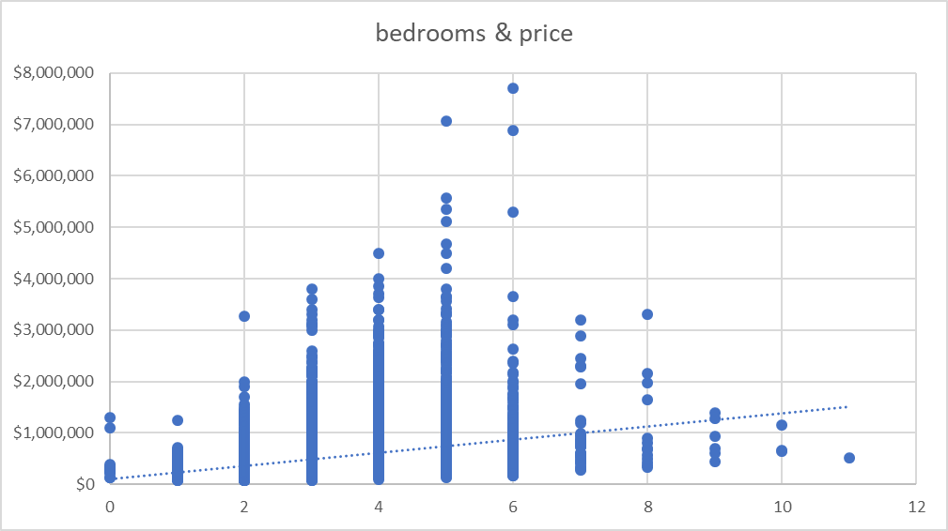
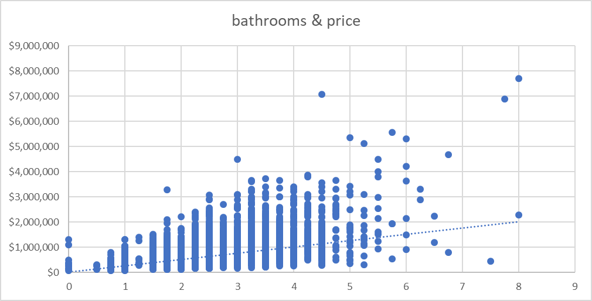
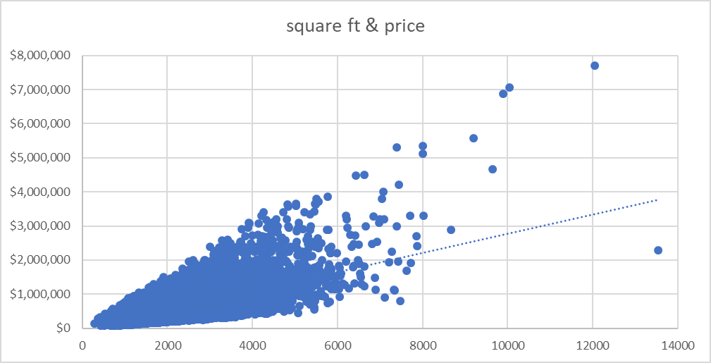
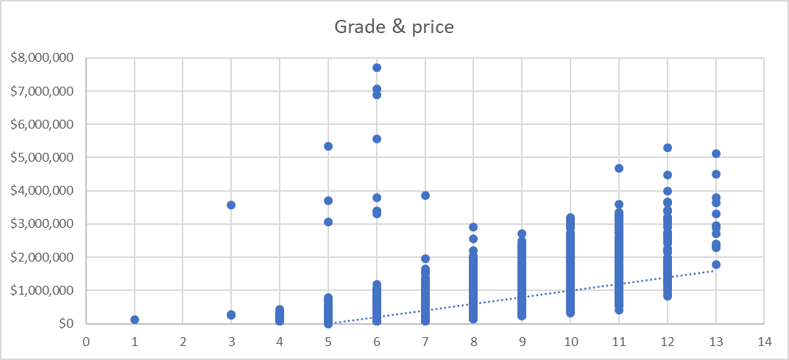
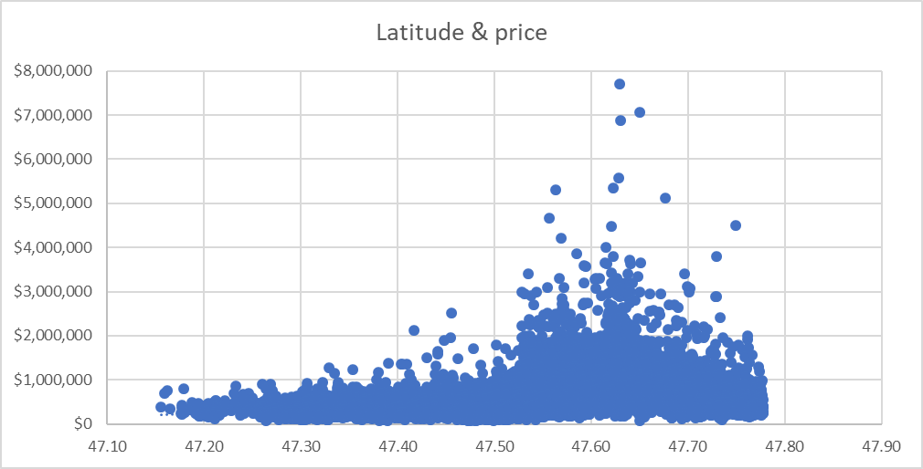
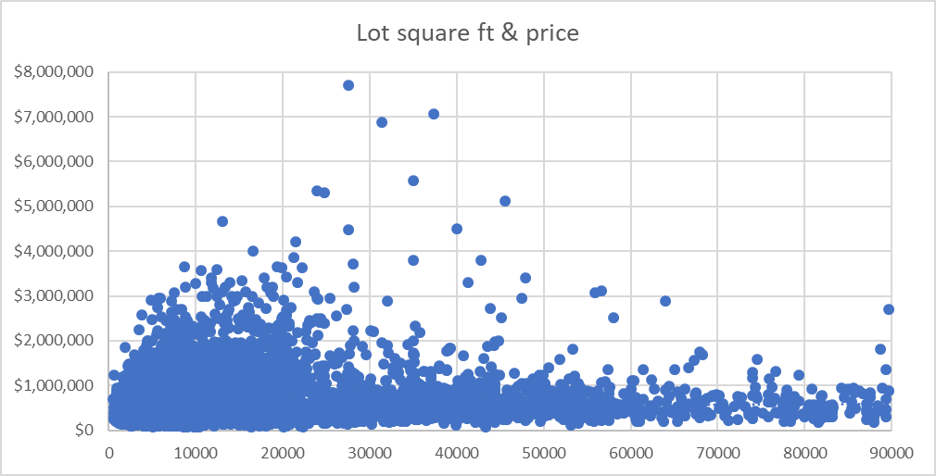
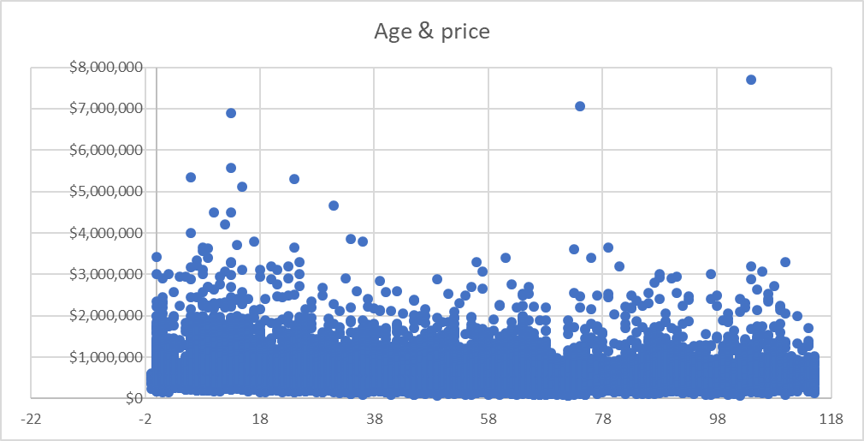
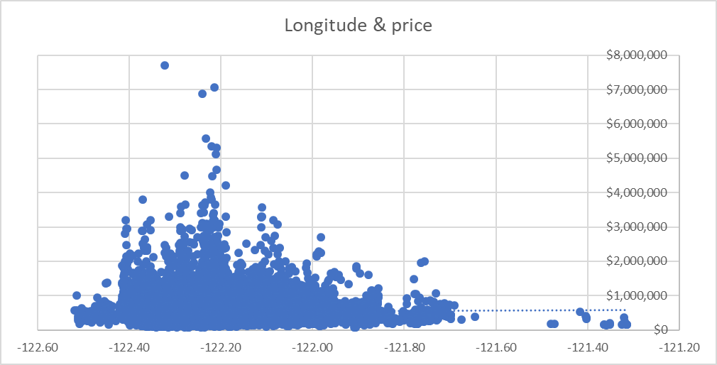
EDA (exploratory data analysis) was initially conducted through visual scatterplots comparing housing price with other variables which showed that some variables have linear relationships with price that may serve as good price predictors while other variables don’t appear strongly related to price.
Source: King County WA May 2014-May 2015 Housing Data (Kaggle)
House square footage, # of bedrooms, # of bathrooms, and grade all appear to have positive relationships with price
House age and lot square footage do
not show strong linear relationships with
price and therefore aren’t likely to be useful
price predictors
A stronger price relationship is apparent for latitude (North/South) than longitude (East/West) which suggests more expensive houses are found in Northern King County

Slide 4
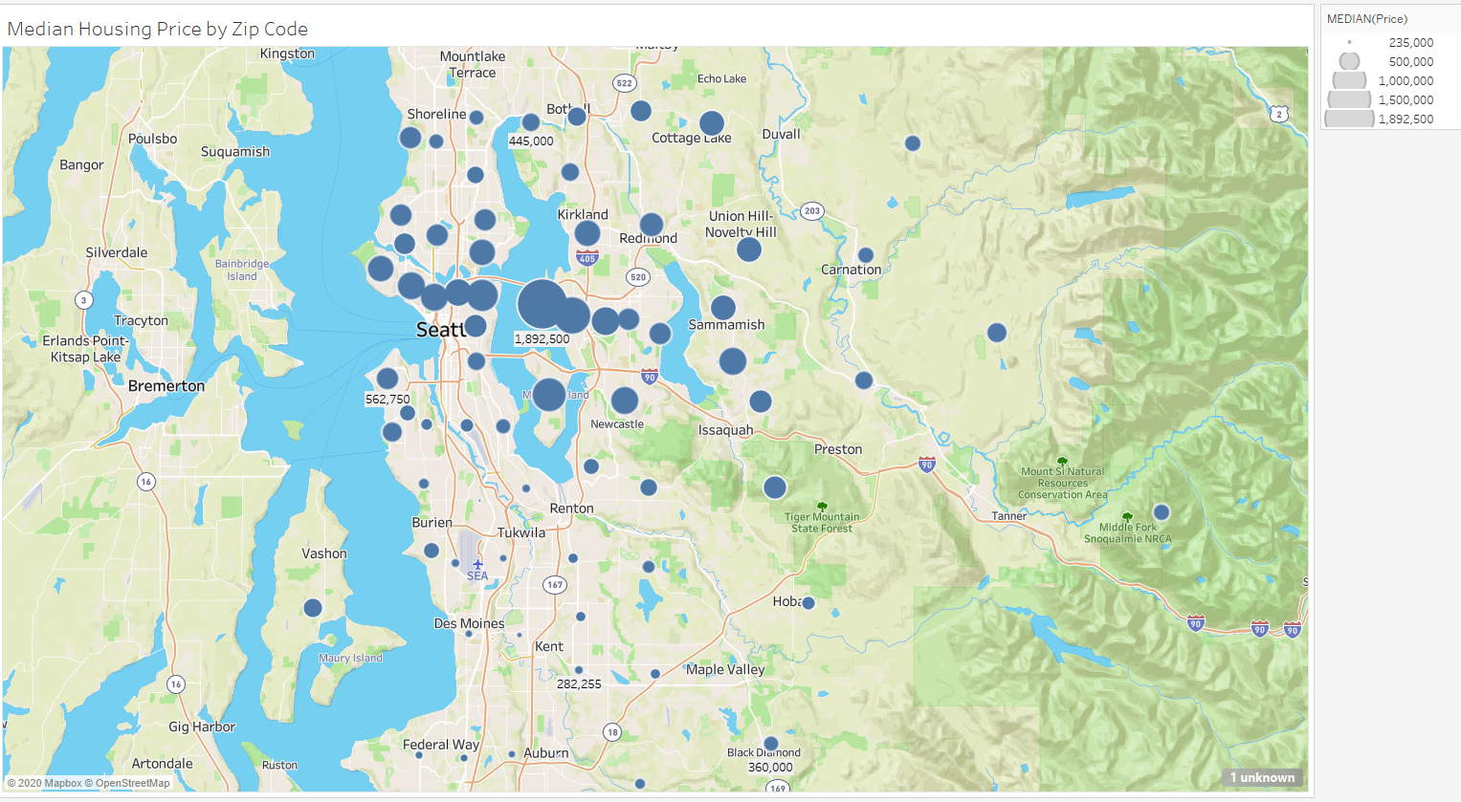
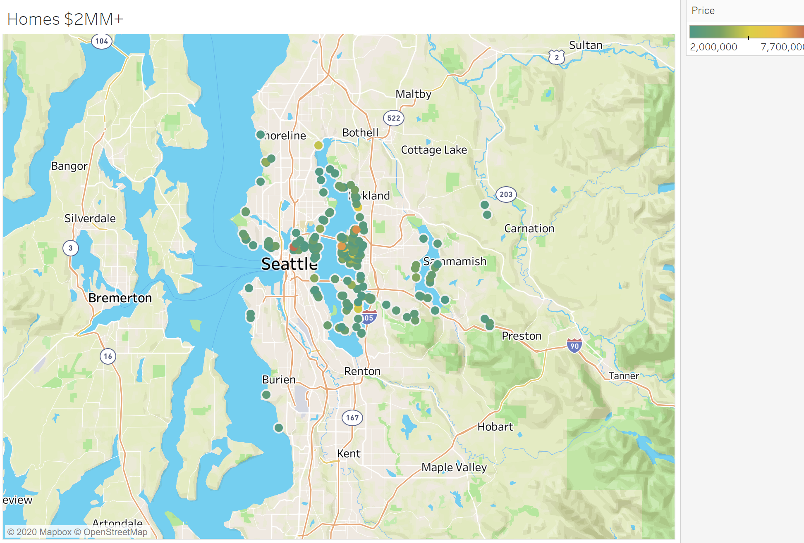
Echoing scatterplots and subsequent correlation analysis, Tableau geographic charts show housing prices generally increase as latitude increases (South to North) but doesn’t noticeably change with longitude (West to East). In addition, waterfront houses are associated with higher prices.
Median Housing Price by Zip Code
Homes $2MM+
The highest priced areas are close to Seattle and Bellevue on both sides of Lake Washington and decrease moving North beyond that. North King County is clearly higher priced than South King County.
The majority of house prices that are $2MM or more are located near water in the Seattle/Bellevue area and none exist in far south King county
The average price of waterfront homes is more than $1MM more than non-waterfront
Source: King County WA May 2014-May 2015 Housing Data (Kaggle)

Slide 5
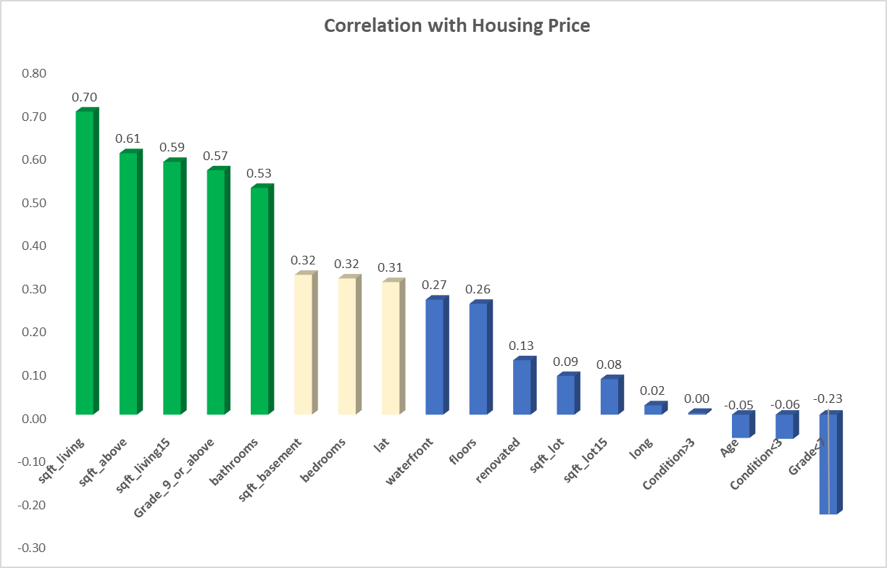
A statistical correlation analysis with housing price further confirmed likely variables that stood out in the previous visual analysis as having a significantly positive relationship with housing price (lead by house square feet, high grade rating, and # of bathrooms).
5 variables are strongly correlated with housing price (correlation coefficients >= 0.5)
sqft_living (0.7)
sqft_above (0.61)
sqft_living15 (0.59)
Grade_9_or_above (0.57)
# of bathrooms (0.53)
3 variables are moderately correlated with housing price (correlation coefficients >= 0.3)
# of bedrooms (0.32)
sqft_basement (0.32)
latitude (0.31)
Echoing the descriptive stats scatterplots, lot size, longitude,and age show little correlation with price and therefore are likely not good housing price predictors. While condition showed a visual positive relationship to price in scatterplots, it shows a weak statistical correlation.
Note: Certain non-continuous variables like grade and condition were binned into groupings as categorical (“dummy”) variables (ex: Grade_9_or_above) for usage in correlation and regression
Source: King County WA May 2014-May 2015 Housing Data (Kaggle)

Slide 6
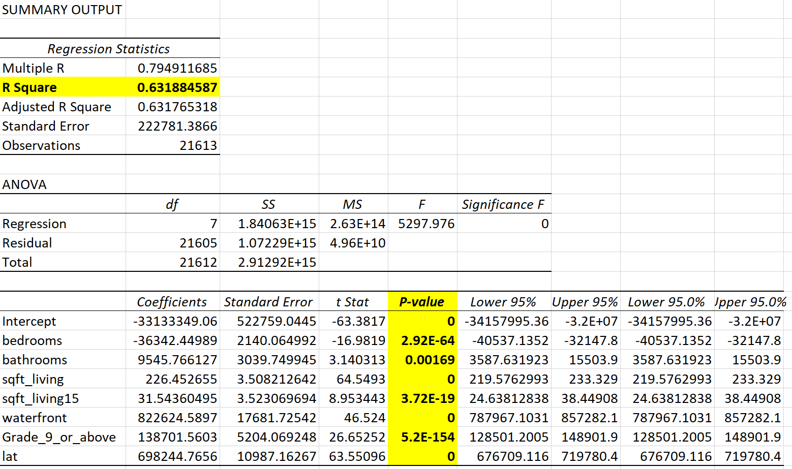
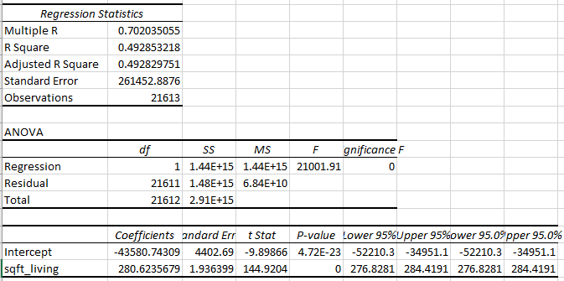
A multiple linear regression model incorporated multiple variables most likely to influence housing price (while excluding those with weaker relationships for simplicity) and resulted in a R Square value of 0.632 (63.2% of price variability explained by the input variables). This is more accurate than a simple linear regression only involving the highest correlated variable (sq feet living).
Variables chosen for final regression model:
# of bedrooms
# of bathrooms
sqft_living
latitude
sqft_living_15 (sqft of nearest 15 neighbors)
waterfront (yes or no)
Grade_9_or_above (construction quality)
All chosen variables have extremely low P-values (well below 0.05) indicating they are statistically significant.
Variables were NOT chosen for final regression model if they didn’t materially affect R Square or presented other precision issues:
lot size, age, longitude, floors, condition, renovation (low price correlation/relationship)
sqft_basement and sqft_above (did not significantly affect regression r square and are highly correlated with sqft_living which could result in overfitting, so opted to just use sqft_living for model simplicity)
Grades less than 9 (high P-Value minimizes statistical significance and didn’t materially increase r square)
Multiple regression incorporating chosen variables: 0.632 R Square
“Simple” regression with only sqft_living variable: 0.49 R Square
Source: King County WA May 2014-May 2015 Housing Data (Kaggle)

Slide 7
Appendix – King County Housing Descriptive Statistics

Slide 8
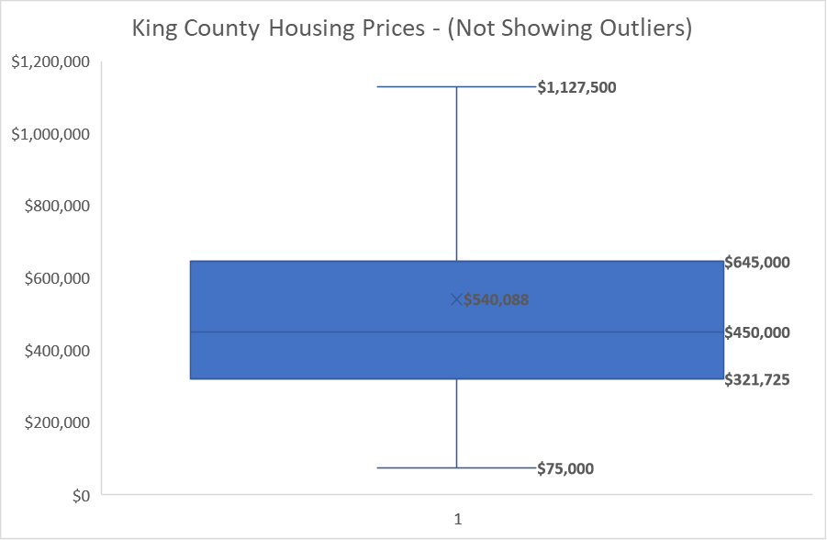
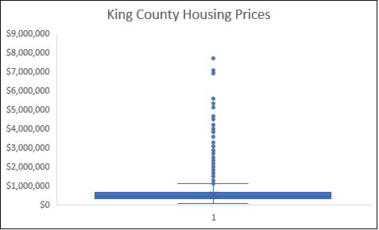
King county housing price – the dependent variable – is $540k on average and is highly positive skewed related to statistical outliers over $1.3 M
Key Descriptive Stats Measures of Housing Price
Mean - $540,088
Median - $450,000
Mode - $450,000
Standard Deviation - 367,127
Skewness - 4.024
Range - 7,625,000
Min – 75,000
Max – 7,700,000
# of records – 21,613
Quartile Info
Q1 - $321,725
Q3 - $645,000
Interquartile Range (IQR) - $323,275
Outlier threshold - $1,129,913
# of “outliers” – 1,146
Outliers
Quartile 3
Median
Quartile 1
Source: King County WA May 2014-May 2015 Housing Data (Kaggle)

Slide 9
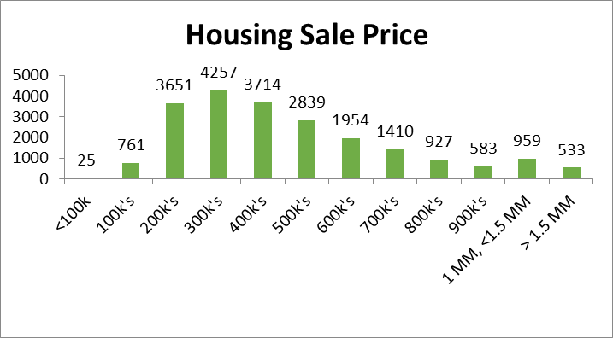
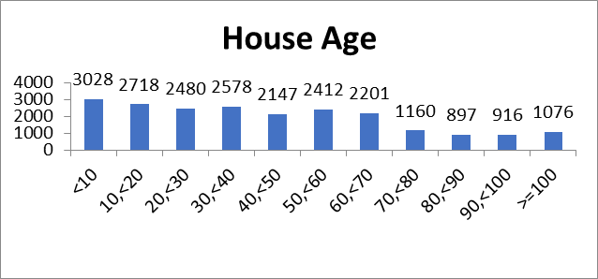
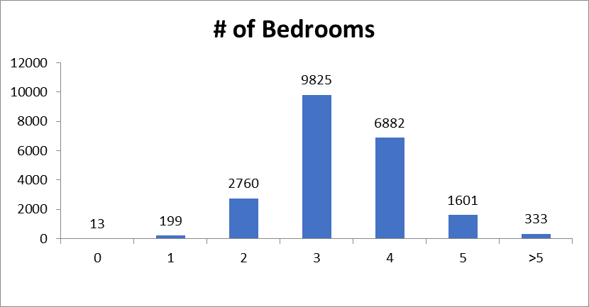
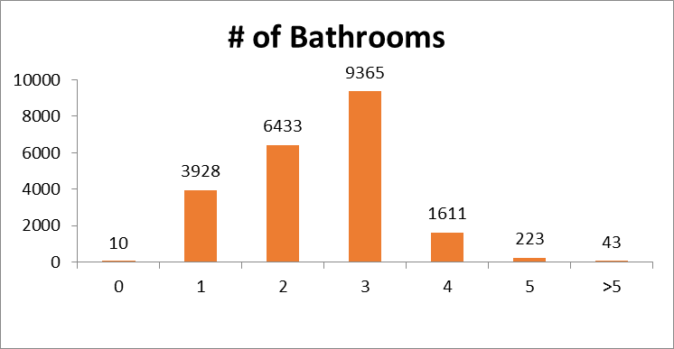
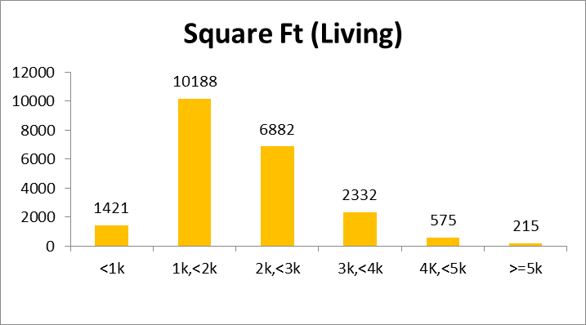
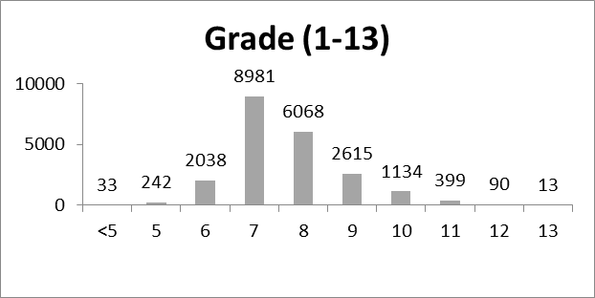
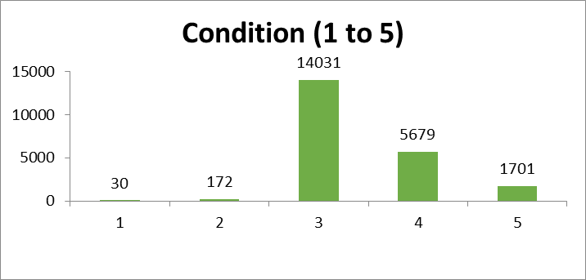
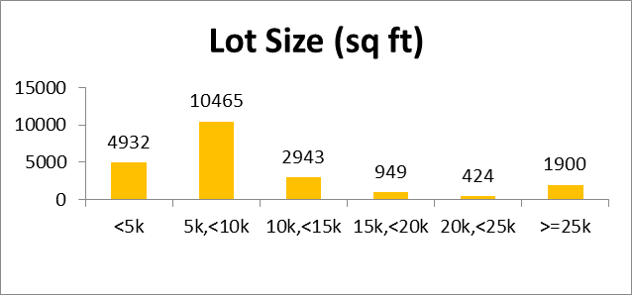
Frequency histograms for the different housing variables give insight into the relative distribution of each value bucket
Source: King County WA May 2014-May 2015 Housing Data (Kaggle)
93% sold for < $1MM
40% >= 60 years old
14% >= 3000 sq ft
65% are 3 (out of 5) condition and only 0.9% are rated below 3
20% have grade rated 9 or above
59% have 3 bedrooms or less
48% have < 3 bathrooms
71% have lot size < 10,000 sq ft

